Slide 1




GANBATTE KUDASAI!
Virtual Anime
GAME NIGHT
BRING OUT THE POWERFUL OTAKU IN YOU

Slide 2

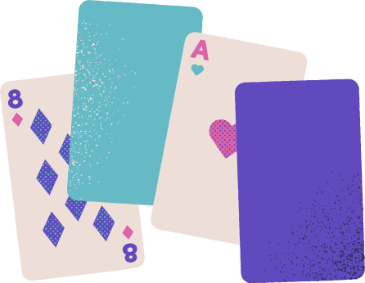

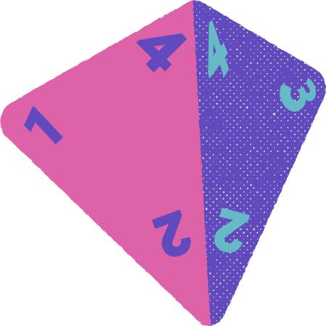
Virtual Anime
Game Night
Tip: Download this background and use it in the online call with your family, friends, and colleagues.

Slide 3
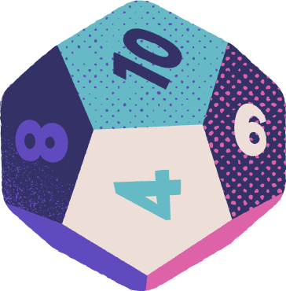
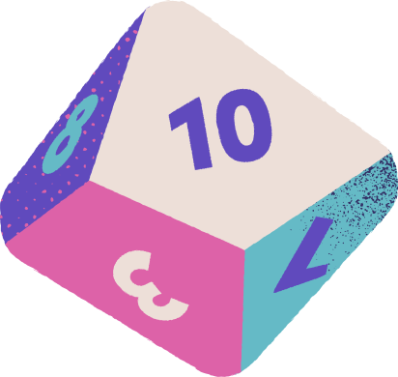
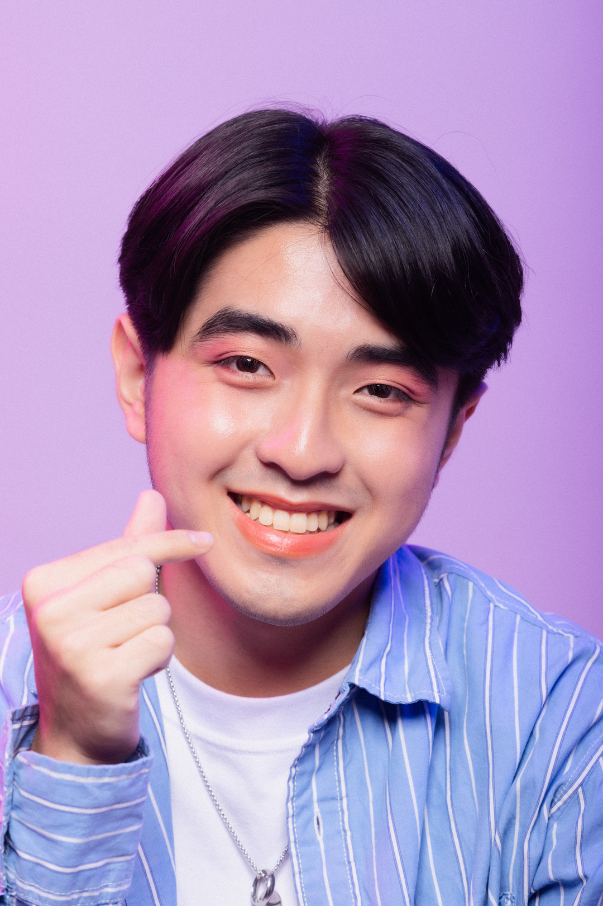
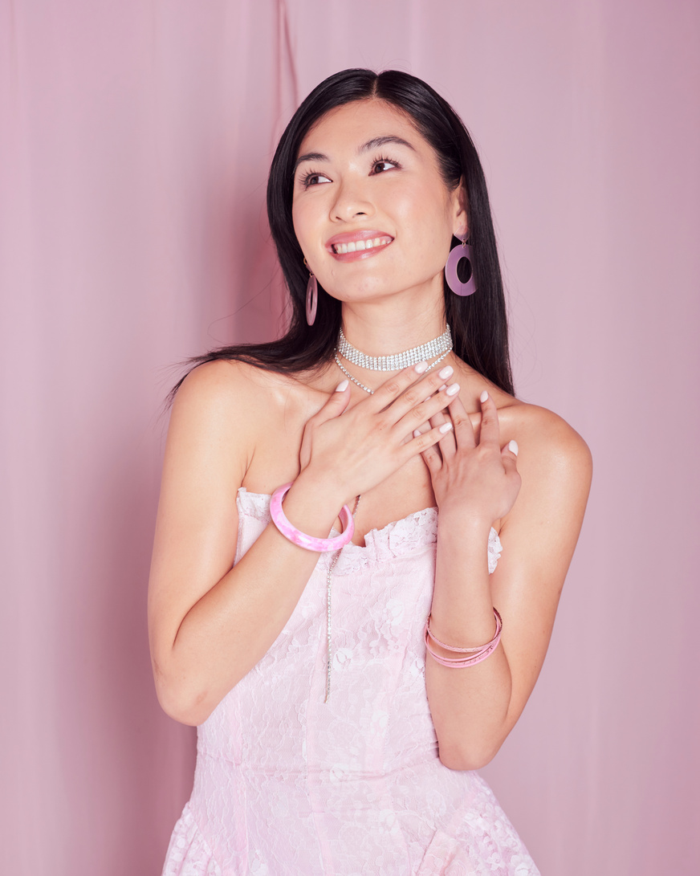
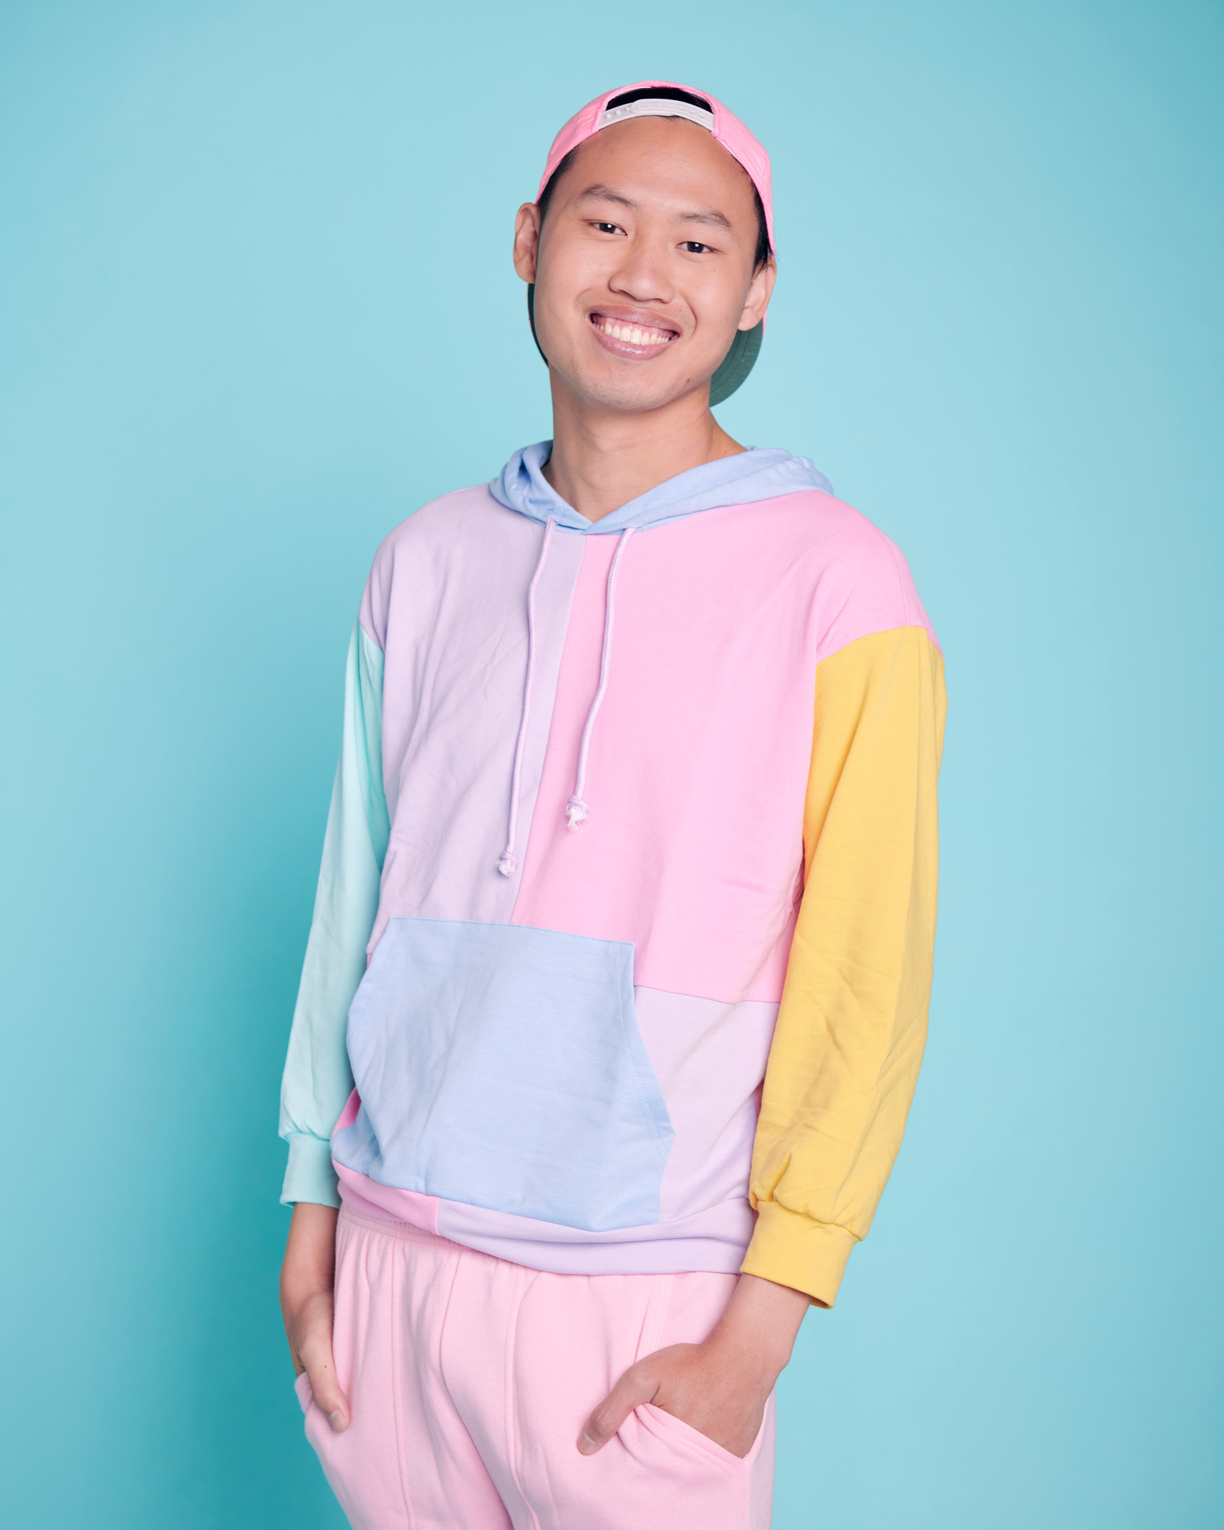


Game Master
Players
Natsu-kun
Haru-chan
Aki-san
Fuyu-sensei

Slide 4



Categories
Guess the Anime
Mad Libs Challenge
This or That
Trivia
Name, Place, Animal, Thing
Tip: Use links to go to a different page inside your presentation.
How: Highlight text, click on the link symbol on the toolbar, and select the page in your presentation you want to connect.

Slide 5


Guess the Anime
Mechanics:
01
The game master will show
a set of four anime-related
photos to players.
02
The first player who guesses the anime title correctly within the time limit wins the point.
BACK TO GAME CATEGORIES

Slide 6

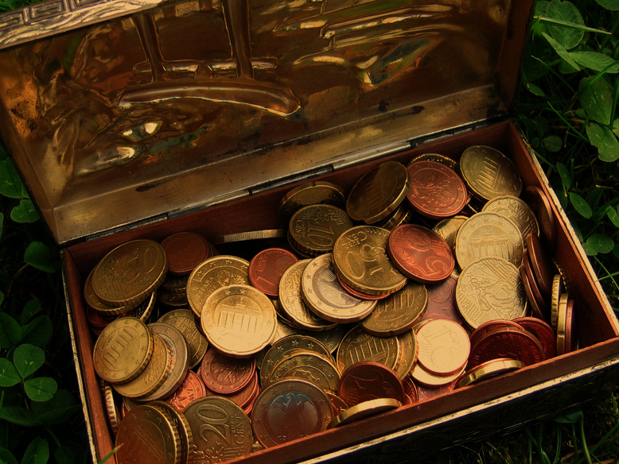


Guess the Anime
Can you tell the anime from these clues?
Move this to reveal answer
The Pirate Treasure
Note to game host: Duplicate this page to create more Guess the Anime questions.
Additional tip: Set a time limit for your players by using the timer located on the lower left side.

Slide 7



Mad Libs
Challenge
Mechanics:
01
The game master will list a set
of prompts.
02
The players will replace the listed prompts with words related to their favorite anime character within the set time limit.
03
The game master will determine which player has the wittiest or wackiest words and award the point to that individual.
BACK TO GAME CATEGORIES

Slide 8


Mad Libs Challenge
Step 1: Use the prompts to list words related to your favorite anime character.
weather
name
name
occupation
place
thing
creature
verb
verb
noun
Note to game host: Duplicate this page to create more Guess the Anime questions.
Additional tip: Set a time limit for your players by using the timer located on the lower left side.
PLAYER 1

Slide 9
Mad Libs Challenge
Step 2: Substitute the blanks with the words you wrote. Have fun!
weather
name
name
It was a normal
day.
and
who were ordinary
occupation,
place
thing
were going to the
to buy
when a
creature
verb
appeared and
them all of a sudden. Reacting quickly, the two
verb
noun
the creature successfully. And that's how their lives as
began.

Slide 10



This
or That
Mechanics:
01
The game master will set two choices from which each player must choose one.
02
The players must explain and defend
their answers.
03
The game master will award the
point/s to the player who provides
the best explanation.
BACK TO GAME CATEGORIES

Slide 11
Give them a hug
Send them a flying kiss
or
This
or That
Have their skill for a day
Change their power
or
Fight alongside with
Spend a peaceful day with
or
What would you
choose to do for or
with your favorite
anime character? Best explanation gets a point.
Borrow their costume
Give them a new costume
or
Watch a movie with
Go on a picnic with
or

Slide 12


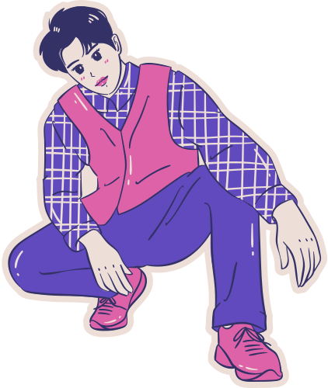
Trivia
Mechanics:
01
The game master will list common
anime-related categories.
02
The players will list their answers in each category within the set time limit.
03
The player with the most number of answers per category will get the point/s.
BACK TO GAME CATEGORIES

Slide 13


Trivia
Name as many characters from different animes with the same power or abilities.
Super Strength | Healing | Psychic/Telekinesis
Write here Write here Write here | Write here Write here Write here | Write here Write here Write here
PLAYER 1
Note to game host: Duplicate this page to create more Guess the Anime questions.
Additional tip: Set a time limit for your players by using the timer located on the lower left side.

Slide 14
Name, Place, Animal, Thing
Mechanics:
03
Each player will think of an answer starting with the unveiled letter for each category that the game master has set.
01
The game master will set anime-related categories (protagonists, villains,
anime title, etc.).
04
If a player repeats an answer which
has already been said or is not able to provide one within the time limit,
they will be eliminated.
02
In each round, the player will pick a card and move it to reveal the letter underneath.
The last person remaining will win
the point.
05

Slide 15
1
2
3
4
5
6
7
Name, Place, Animal, Thing
Y
N
D
H
C
A
X
8
9
10
11
12
13
14
M
J
R
W
P
T
U
15
16
17
18
19
20
21
O
G
B
V
L
Z
I
22
23
24
25
26
S
E
F
Q
K

Slide 16
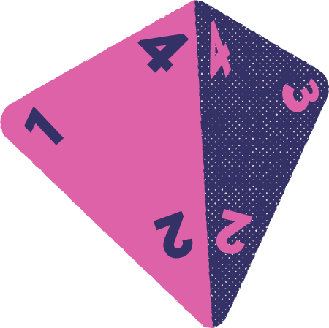
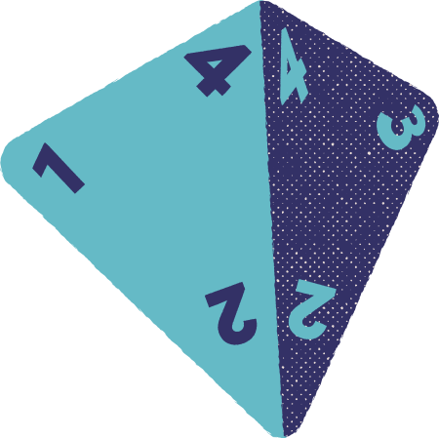
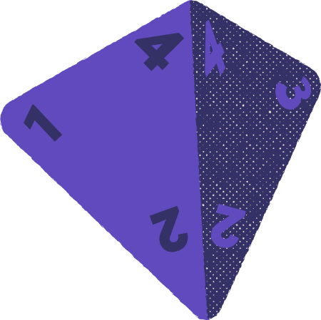
Scoreboard
Natsu-kun
Haru-chan
Aki-san

Slide 17
Wonder Weeb
Award
Subarashi desu! This award goes to you for scoring the most points and demonstrating your extensive anime knowledge. You have earned the position as our new sensei!

Slide 18
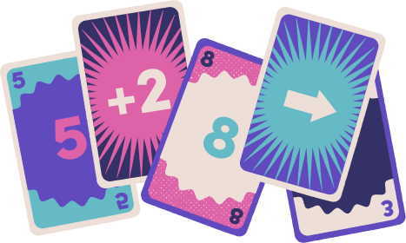




Arigathanks gozaimuch
for playing, minna-san!
We hope you enjoyed our anime game night. Until our next one. Sayonara!
@reallygreatsite

Slide 19



Copy a note, drag to the board, and write your ideas.
Copy a note, drag to the board, and write your ideas.
Whiteboard Page
Write a note here
Write a note here
Tip: Collaboration makes teamwork easier! Click "Share" and invite your teammates to fill this up. Use this whiteboard page for bulletins, brainstorms, and other fun team ideas!

Slide 20
Add more
sub-ideas
Add even
more sub-ideas
Need a timer?
Find the clock symbol on the lower left and start brainstorming!
Add a
related idea
Add more
sub-ideas
Add even
more sub-ideas
Add a
related idea
Add a main topic
Add a
related idea
Add even
more sub-ideas
Add more
sub-ideas
Add a
related idea
Tip: Collaboration makes teamwork easier! Click "Share" and invite your teammates to fill this up. Use this whiteboard page for bulletins, brainstorms, and other fun team ideas!
Add even more
sub-ideas
Add more
sub-ideas

Slide 21


Resource Page
Use these design resources in your Canva Presentation. Happy designing!
Delete this page before presenting.

Slide 22
Resource Page
Use these design resources in your Canva Presentation. Happy designing!
Delete this page before presenting.

Slide 23
B for blur
C for confetti
Resource Page
D for a drumroll
M for mic drop
O for bubbles
Q for quiet
Find the magic and fun in presenting with Canva Presentations. Press the following keys while on Present mode!
Delete this page before presenting.
U for unveil
Any number from
0-9 for a timer

